Slide 1

THE CAREMATRIX PROJECT
Pre-Commercial Public Procurement (PCP) – Open Market Consultation (OMC)
2021/11/24
The project (CareMatrix) has received funding from the European Union’s Horizon 2020 research and innovation programme under grant agreement No 964370.

Slide 2
For English speakers
International OMC december 14th!
2021/11/24
The project (CareMatrix) has received funding from the European Union’s Horizon 2020 research and innovation programme under grant agreement No 964370.

Slide 3
Agenda
Introduktion
Vinnova - Innovation & innovationsupphandling
Region Skåne - Main challenge & scope
CAREMATRIX Open Market Consultation
Q&A
Upphandlingsmyndigheten – Upphandling och innovationsupphandling
Förkommersiel upphandling – verktyget och projektprocess
Q&A
Bolagsstöd och matchmaking

Slide 4
Praktisk info !
Frågor → chatten, eller spara till Q&A!
Tysta mikrofonen under presentationer
Inspelning - transparens

Slide 5

The CareMatrix buyers group are supporting the development of technology solutions and tools that anticipate and adapt to the changing needs of people with multimorbidity by ensuring timely service access, co-managed care journeys and transitions between specialties and sectors.

Slide 6
Open Market Consultation (?)
The OMC basically consists of an in-depth dialogue and provides an overview on the procurement objectives, the PCP process and the main clauses of contracts.
The OMC is announced by the PIN (Prior Information Notice) and it is performed to:
initiate the formal dialogue between CareMatrix buyers and the market players,
identify the gap between state-of-the art industry development and the identified needs,
provide a clear justification of the need to procure R&D services (confirm the PCP),
provide input to finetune the request for tender requirements (ITT) and its annexes,
enable and increase the opportunities for the suppliers to form fit-for-purpose consortia,
identify market risks potentially able to endanger business goals and supplier performance.
Notes:
.. Vill speciellt lyfta

Slide 7
The Consortium
The project consortium is made up of 7 partners from 4 EU countries includes Innovation Skane AB as
coordinator, the International Foundation for Integrated Care (IFIC), Norway Health Tech, Basque Foundation for Health Innovation and Research (BIOEF), and healthcare providers Vestre Viken HT, Region Skåne, and Basque Health Service Osakidetza.

Slide 8
Innovation Skåne är det regionala innovationsbolaget.
Vi bidrar till regional tillväxt och framtidens välfärdstjänster genom innovation.

Slide 9
INNOVATION SKÅNE
DET REGIONALA INNOVATIONSBOLAGET
Region Skånes helägda innovationsbolag
  45st innovationsledare
Verksamma inom
  Hälsa
  Mobilitet
  Foodtech
Notes:
Fakta om oss – ca 30 heltidstjänster

Slide 10

Opportunities in Healthtech
Marianne Larsson – Innovation Skåne

Slide 11


Hälsa
Notes:
Global Health has improved tremendously during the last decades.
However, other circumstances – life style changes, elderly population
increase chronic diseases and REDUCTION in ACCESS to healthcare,
Even in countries like The Nordics,
where Iceland and Sweden are
Ranked the healthiest countries in the world, together with Singapore
With gov funded healthcare to ALL
Today, people wait for months to be treated.
In areas like rural Africa, a parent may have to walk for days to reach a doctor for a sick child.
50% of world population don’t have access to healthcare.

Slide 12


We’re on a health mission
Bättre hälsa för alla

Slide 13
Empowering the Individual
Profession
Patient
Patient
&
Profession
Patient
Notes:
HealthTech fungerar så att om man kombinerar intelligenta verktyg för patienter med intelligenta verktyg för profession når man helt nya resultat
Här ser ni några exempel.
TO the left
HealthTech for cardiac or other chronic conditions, helping people help themselves,
While profession identifies those with needs automatically. Amongst thousands.
As opposed to seeing them, whether they need it or not, every 6 months. Or too late, in the Emergency Room.
These tools save lives!
To the right, Joint Academy, treating arthritis, Reducing pain and need for surgery, at ¼ of the traditional cost.
----
If I have a heart condition.
I’ll be happy to have the Coala Heart Monitor,
UPDATING me on my HEART CONDITION in 1 minute.
Alerting specialists, should I need it.
Here’s Life Pod, assisting profession.
Sorting thousands of patients into THOSE who are IN NEED of CARE, WHEN they need it.
As opposed to seeing them every 6 months whether they need it or not, or in the ambulance when really bad.
This saves lives.
The third picture is OptiLogg, specifically designed for simplicity for old people, and much appreciated.

Slide 14
Hospitalization
50%
[Improved Quality of Life]
Gerward, S, et al., n.d. Skåne University Hospital
Notes:
Allt fler studier visar att HealthTech för patienter och profession
HealthTech has already proven to reduce need for hospitalization of chronics by 50%. While improving Quality of Life.
----
Life Pod and OptiLogg reduce hospitalization of Heart Failure patients by 50%. While increasing life quality for the patients.
(And actually providing new knowledge to the profession, for instance leading to revised medication.)
JointAcademy reduce pain and need for surgery more than its ancestors at ¼ of the cost
Life Pod is currently implemented for a large variety of chronic patients, in Skåne.

Slide 15
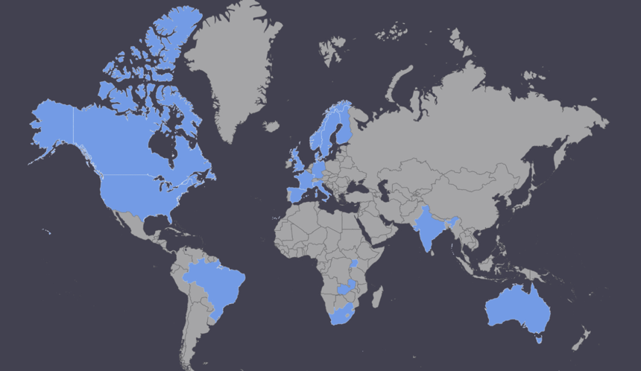
+300
2/3
Touching the lives of Millions
On all continents except Antarctica
Notes:
HealthTech Nordic, over 300 selected members, 2/3 available on the market.

Slide 16
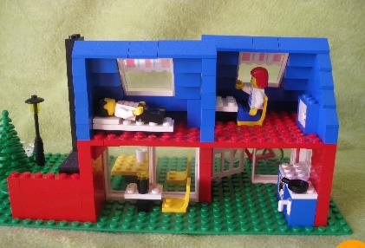

Vi vet redan…
- fakta om lösningar
Kombination av digitala verktyg för patient och profession
Minskar behovet av sjukvård med >50% (hjärtsvikt m m)
Ger ökad trygghet (gamla)
Ger bättre resultat till ¼ av kostnaden (artros)
Positiv upplevelse för såväl patient som profession (hjärtsvikt m m)
Ger livsstilsförändringar på riktigt (Diabetes II)
FRIGÖR RESURSER
ÖKAR TILLGÄNGLIGHET VID BEHOV

Slide 17

Wave by wave
Across the globe
1: Online visits
Improved access
Current technology applied on traditional healthcare processes
Increasing in the Nordics
2: Smart Individual support and treatment. Smart professional tools.
Improved health and life quality, reduced need for expensive care. “More health for the buck.”
Paradigm shift. Affordable.
Future
3: Real time data, large populations, smart analytics
Accelerated development of new diagnostics and treatment
Notes:
The second wave is currently being implemented around the Nordics.

Slide 18
Mer hälsa för pengarna

Slide 19
HealthTech market
Prior to Covid-19
200-500 bn $ per year (different institutions)
1% corresponds to 5 000-20 000 jobs
In 2014 – Few investors
In 2020 - Global investments increased by 45%
Sources:
https://www.beckershospitalreview.com/healthcare-information-technology/9-predictions-for-digital-health-in-2020.html
https://www.grandviewresearch.com/press-release/global-digital-health-market
https://www.prnewswire.com/news-releases/worldwide-digital-health-market-to-hit-504-4-billion-by-2025-global-market-insights-inc-300807027.html
**Soaring Healthtech Investment Is More Than Just A Shot In the Arm - GHP News (ghp-news.com)
how-covid-19-has-changed-the-way-us-consumers-think-about-healthcare.pdf (mckinsey.com)

Slide 20

Trendspaning Healthtech internationellt
Branschförflyttning?
Amazon, JP Morgan, Wahlmart, mobiloperatörer, Apple, Google m fl – alla satsar på Hälsa
  Upprepade försök
  Samma kärna?
Hälsobranschen (t ex läkemedelsindustrin) satsar på Tech
  Främst i befintlig verksamhet/affär? (T ex effektivare läkemedelsutveckling, smartare version av produkten)
Konsolidering inom HealthTech
Redan dominanta online-visit-företag kompletterar sig med lösningar från andra healthtech-företag.
  Svenska exempel: MinDoktor – dermatologi, beslutsstöd, Kry – psykolog/terapi, Capio Go – monitorering av äldre i hemmet.
Vilka kommer att leda paradigmskiftet?

Slide 21
Hälsa
1+1=5
Notes:
Oavsett – hoppas jag ha inspirerat till att samarbeta – kombinera tekniskt och affärsmässigt - för bidra till friskare männsikor och bättre vård för pengarna.

Slide 22
Tack!

Slide 23

Animation

Slide 24
Vinnova – Sveriges innovationsmyndighet
Nina Widmark

Slide 25
Hur spelar upphandling roll för forsknings- och utvecklingsprojekt?

Slide 26

Vinnovas erfarenheter
Behovsägare i offentlig sektor saknas i vissa projekt = nya lösningar motsvarar ej offentliga behov tillräckligt väl
Behovsägare är med, men lyckade FoI-prototyper kan inte upphandlas eller införas (t.ex. pga konsultjäv)
För få utlysningar i FoI-bidragsystemet stöder projekt med upphandlings-upplägg
Mer kunskap behövs om möjligheten att arbeta med innovationsupphandling (offentlig sektor) och att lämna anbud i innovationsupphandling (företag)
Viktigt att IUpp-projekt möjliggör för företag att kommersialisera och skala.
Notes:
Några vanliga exempel:
I ansökningar och satsningar på företags utveckling av nya lösningar tänkta för offentlig sektor är inte alltid behovsägarna (dvs offentlig sektor) representerade, eller kommer in först i slutet av projekten. Tydligare involvering av offentliga behov behövs.
Upphandling av innovation ses inte alltid som ett alternativ när en nya lösningar ska tas fram i offentlig sektor. Intern utveckling eller samverkansprojekt är vanligare val, eller att köpa en gammal lösning. Innovationsupphandling behöver bli ett naturligt alternativ för utvecklingsprojekt i offentlig sektor. Inte heller upplever vi att företag tillräckligt väl känner till möjligheterna med att lämna anbud i innovationsupphandling.
Relaterat: När offentlig sektor deltar i samverkansprojekt är det oftast från utvecklingssidan – upphandlingskompetens deltar ej, eller kommer in alldeles för sent. Det kan skada projektens möjlighet att gå hela vägen till införande och effekter.
Företags möjlighet att kommersialisera och skala, växa och få fler kunder, är viktigt för att offentlig sektor ska få stabila leverantörer som kan erbjuda volymleveranser. Möjlighet till kommersialisering och skalning bedöms alltid i våra företagsfinansieringar, men i projekt med offentlig sektor tappas denna aspekt bort ibland.

Slide 27
I PRINCIP ALL INNOVATION SOM
ÄR MENAD FÖR OFFENTLIG
SEKTOR KOMMER ATT INNEBÄRA UPPHANDLING
Notes:
Allt utmynnar i denna insikt: innovation menad för offentlig sektor kommer att innebära upphandling.

Slide 28



Tre ingångar för FoU-projekt
Tidig konkurrens-utsättning
=
innovationsupphandling
Undvik orättvisa fördelar
FÖRBERED FÖR offentliga affärer
Notes:
Tidig konkurrensupphandling
Vill en offentlig verksamhet söka brett efter utvecklingspartners?
Vill företagspartners känna sig säkrare på att få leverera?
Vill man kunna inkludera företag som behöver mer ersättning än vad statsstödsreglerna tillåter?
Undvik orättvisa fördelar
Har företag idéer om nya lösningar för offentlig verksamhet?
Deltar möjliga offentliga kunder i ett utvecklingsprojektet?
Ligger en möjlig upphandling i nära anslutning till projektet?
Förbered för offentliga affärer
Behövs offentlig upphandling för att införa nya lösningar?
Får företag förutsättningar att kommersialisera och skala?

Slide 29
Regeringsuppdrag
Uppdrag till tre myndigheter:
Stärka möjligheten för innovationskedjans aktörer att nyttja extern kompetens,
Främja användningen av innovationsupphandling, och
Medvetandegöra betydelsen av strategisk hantering av immateriella tillgångar
Innovations-upphandlingsarena (Upphandlings-myndigheten)
Kunskap om intellektuella rättigheter (PRV)
Innovationscheckar och innovationsledning (Vinnova)
2021-04-08 I 3 (AH) Nyttiggörande och kommersialisering av innovation KOPIA (002).pdf

Slide 30



På Vinnova
Innovationscheckar till SMF, SMÅ OCH MEDELSTORA företag
Innovationslednings-stöd
Innovationscheckar till upphandlande myndigheter
Innovationscheckar: medel för att köpa in extern expertis, specialiserad rådgivning samt extern infrastruktur för innovation.
Dessutom stöd till efterfrågeacceleratorer, SIP-satsningar etc. utanför regeringsuppdraget.

Slide 31

Checkar för innovationsupphandling
Pilotsatsning hösten 2021
Vårens aktiviteter är under planering
Länk: Checkar för innovationsupphandling 2021 - pilot | Vinnova
Notes:
En utlysning på området Transformativ Offentlig sektor och Civilsamhälle på Vinnova samt Regeringsuppdrag N2021/01194.
Vinnova har precis lanserat en pilotsatsning för att möjliggöra innovationsupphandling inom offentlig sektor.
Den här satsningen är en del av det gemensamma regeringsuppdrag som Vinnova har fått tillsammans med Upphandlingsmyndigheten och Patent- och registreringsverket, PRV.

Slide 32
Nina Widmark, nina.widmark@vinnova.se

Slide 33
Main challenges and identified needs regarding care for patients with multimorbidity

Slide 34

Main challenges in multimorbidity management
up to 95% of people older than 65 years may be affected by multimorbidity
Two or more chronic conditions
  COPD,
  Heart failure,
  Diabetes,
  Mental health,
  Etc.
Significantly reduced quality of life for the individual, and costly for care providers
the increasing demand for technology solutions and tools that anticipate the changing needs of people with multimorbidity
Notes:
Let´s talk about the challenge, or unmet need, that we are specifically adressing in this project. Enabling tools for people living with multimorbidity.
This is a large patient group, as up to 95% older than 65 years old are affected.
The patient with multi-morbidity is defined as bearing two or more chronic conditions, and
As populations get older this group only gets larger – with more financial burden for care providers allocated to not only treatments but also to the coordination of care. Which very often are inefficient and little adapted for this patient group.
As you can tell from this image the challenge is a multi-faceted one, but what we seek is technology solutions and tools that anticipate the changing needs of people with multimorbidity
34

Slide 35
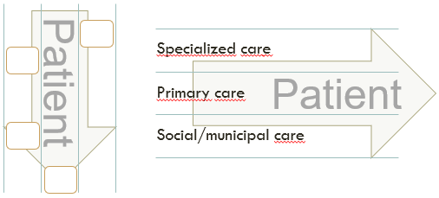
Addressing the white spaces between silo-based single-diagnosis treatment tracks, and the white spaces occurring in caregiver transitions
Common challenge
Tools that share and improve personalised real time data analytics across care for the patient, their designated care manager, virtual teams and informal caregivers.
Diagnosis silos
Caregiver silos
Sub-challenges
Stabilising conditions from a holistic perspective
Increased self-care capacity
Loss of information in caregiver transitions
Impacts
Increased Continuity of care → reduction in clinical & patient data errors → quality of care
Improved coordination of care → less time spent visiting care facilities → quality of life
Notes:
Life for the patient living with multimorbidity is complex, involving several care contacts and activities or appointments.
In carematrix we are addressing the white spaces between silo-based single-diagnosis treatment tracks, and the white spaces occurring in caregiver transitions
Our common challenge is finding collaborative Tools sharing relevant data across the patient care pathway, for care managers, virtual teams, the patients themselves and informal caregivers.
Inherently this involves a number of sub-challenges such as:
Adressing these have actual real-life impacts for the patient and for the care provisioner:

Slide 36
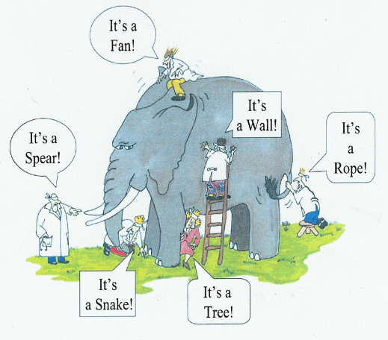

Slide 37
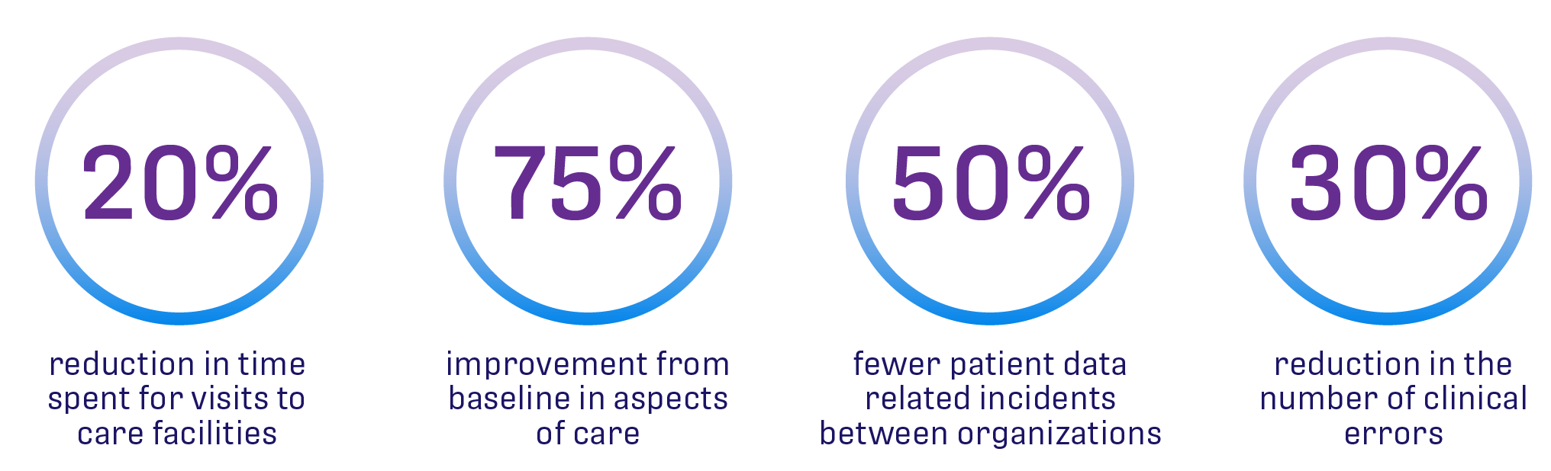
CAREMATRIX expected impacts

Slide 38
CareMatrix Building Blocks Model
Theoretical Care Pathway
Continuous flow
Patient and carer participation all along the process
Följande beskrivs i detalj i projektets
“scope-document”, och kommer att publiceras på projektets hemsida Carematrix.eu

Slide 39
CareMatrix Building Blocks Model
General rationale behind the model:
  Multimorbidity points to the coexistence of two or more chronic conditions in one person
  Den multisjuka personen (PMM) often have confluent care needs, which interact and can affect their capacity to self-care and their risk of health deterioration
  PMM require the attention of multiple care specialties and levels of care, including social care. Improving efficiency demands coordination
  However, traditional care is nevertheless characterized by a silo approach based on single processes per pathology
  This complexity requires prioritization between different therapeutic objectives, treatments and medications
  This prioritization must be based on a comprehensive assessment of a person’s needs and context

Slide 40
Rationale
  Important to identify at an early stage persons at greater risk of becoming multimorbid patients
  PMM often requires care from different professionals and healthcare providers
Current needs/gaps
  Information on a person’s care needs and processes is often siloed across care settings, sectors, specialties and professionals.
  Persons at risk of multimorbidity or further health deterioration are often not identified early enough
  Different measurement tools and scales are used to assess a patient’s health status and care needs.

Slide 41
Suggested improvement areas
  Information systems which also gather and share information on a patient’s values and preferences,
  Shared access to commonly agreed assessment scales

Slide 42
Rationale
  Interdisciplinary work, consensus and coordination as one of the fundamental characteristics of care models for this type of patient. Integrated care as organizational model
Current needs/gaps
  There is insufficient dialogue, collaboration and agreement between the different care professionals and levels
  PMM find themselves attending an unnecessary number of uncoordinated appointments with recommendations and treatments that frequently overlap or even counteract with each other
Suggested improvement areas
  An interdisciplinary or mixed team approach, developing solutions that enable that the stakeholders involved can play their role within that team

Slide 43
Rationale
  it is difficult to follow standard protocols, guidelines or care pathways in the case of PMM, since there are many co-existing conditions and circumstances in each case -- PMM frequently have a heavy self-care burden
  A disease management approach, optimizing the treatment for a single condition, is often not suitable for this kind of patients
  patients require an individual care plan shaped around their personal and specific needs and circumstances,
Current needs/gaps
  PMM follow parallel care pathways for different conditions, a prioritization of care objectives and treatments in the care plan is needed

Slide 44
Suggested improvement areas
  Decision support tools and information systems, which facilitate the individual care plan
    Based on a holistic assessment
    With the participation of the patient
    Considers interaction between treatments
    Considers coordination with social care

Slide 45
Rationale
  PMM face a particular risk of lacking continuity of care in transitions between care levels and settings.
  PMM often do not have an identified point of contact
  Having an identified care coordinator or coordinating team can be fundamental for the continuity of care
  Continuity of care requires communication and coordination between different care professionals
  Continuity of care requires a proactive health care system that monitors health status and intervenes when needed in a preventive manner
Current needs/gaps
  Commonly, different care professionals do not share clinical and social information on the patient.
  Information systems and organizational models often do not ensure timely and automatic transfer of information and communication between care providers at transitions

Slide 46
Current needs/gaps (cont.)
  Lack of identified person/team of reference responsible for coordination
  Health care providers are often not proactive enough in keeping PMM actively and continuously monitored
  Suggested improvement areas
  Ensure a timely and automatic transfer of information and communication between health care professionals (including mental health), levels and settings
  Support the communication of the patient with the health care sector 24/7 and facilitate an identifiable point of contact
  Tools that support a regular follow up and monitoring of patients at home.

Slide 47
Rationale
  A participatory approach is in general a growing trend in health and care, tools already exist that enable empowerment and allow for greater patient and caregiver participation
    patient and caregiver empowerment as an element of secondary prevention that improves patients' health management
Current needs/gaps
  There is a lack of awareness in the vision of the role of patients and caregivers in a coordinated multimorbidity care
  The views, values and preferences of patients and informal caregivers are not sufficiently incorporated
  Apps and other applications that collect information about patients' health are often not integrated. Telemonitoring and self-care tools are sometimes burdensome and time-consuming for PMM and caregivers

Slide 48
Suggested improvement areas
  Tools for patients and carers that show the possible paths of the person in their multimorbidity situation and help them to better manage their condition
  Empowerment platform for telemonitoring and self-care for PMM

Slide 49
CareMatrix Use cases
Use case 1. Tools for early identification of people at risk and/or with multimorbidity based on a holistic assessment and with a preventive approach
Use case 2. Tools supporting the development and follow-up of an individual care plan based on a shared assessment and communication among the interdisciplinary care team, including the patient and/or informal carers
Use case 3. Decision support tools for improved and proactive care for people living with multimorbidity
Use case 4. Tools facilitating seamless transitions and continuity of care, including home care and social care, from a person-centered perspective
Use case 5. Tools supporting empowerment and self-management by the persons living with multimorbidity and their carers, including early detection of complications and signs of deterioration

Slide 50
Open Market Consultation (OMC) and
Next Steps

Slide 51
Aims of the OMC
Initiate the formal dialogue between CareMatrix buyers and the market players.
Identify the gap between state-of-the art industry development and the identified unmet needs.
Provide valuable input to fine-tune the request for tender requirements (ITT)
Supplier matchmaking

Slide 52
OMC Process
Publication of the Prior Information Notice (PIN)
OMC Webinars and other tools for consultation and dialogue
Innovation Gap
Suppliers Information Pack (SIP)
Launch ITT
Scope Document
Use Cases &
RFI Questionnaire
June 2021
Nov-Dec 2021
Jan 2022
Mar 2022

Slide 53
Needs’ identification:
Scope Document and Use Cases
Published shortly
Scope Document: It describes the challenges/needs for a better care for people with multimorbidity identified during the ‘Needs assessment phase’. It identifies a list of five Use Cases. The market will be consulted on those needs, to gather information on the state of the art and available solutions.
Use Cases: A description of the five Use Cases identified in the Scope Document.

Slide 54
RFI Questionnaire: information on the state-of-the-art
November/december 2021
Request for Information Questionnaire: A Request for Information Questionnaire will be published and disseminated to gather information about the state-of-the-art and existing solutions to address the identified challenges/needs. The questionnaire will be opened for feedback from potential suppliers as well as other relevant stakeholders (including medtech experts, research organisations, patients’ associations, care professionals’ associations, health care providers and public agencies).

Slide 55
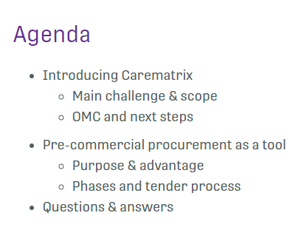

OMC local and international events
3 local OMC Events (one in each Buyers’ Group country) and 1 international OMC Webinar will be organised to present the project’s challenges and PCP process to potential suppliers and other interested parties.
November 2021
14 December 2021

Slide 56

International OMC Webinar
An international concluding webinar in English will be organised, featuring a summary of previous webinars, including relevant issues from local Q&As (for full transparency), an overview of the upcoming tender, and including a session for matchmaking between potential suppliers. This concluding event is planned for 14th of December 2021.

Slide 57
Other tools for consultation
November 2021-January 2022
Questions and answers’ tool at the website: The CareMatrix website will provide a space for asking Questions to the project’s consortium during the OMC process. Answers by the project’s consortium will be published on the website. – opened this week
Considering the need to ensure fairness, transparency, and accessibility to information during the whole OMC process as well as equal treatment of all economic operators, project partners will also report and make public any additional information they will provide during the OMC Events.
Questions and answers’ report: All the information provided through the ‘Questions and Answers’ tool on the website as well as in the OMC Events will be included in a report (‘Questions and Answers report’) which will be made available to all potential suppliers not later that the date of publication of the Invitation To Tender.

Slide 58
Matchmaking and consortia building
November-December 2021
Matchmaking search tool: The Carematrix website will include a matchmaking search tool for potential suppliers interested in forming a fit-for-purpose consortia with other interested suppliers to respond to the future Carematrix tender. The matchmaking space will allow potential suppliers to publish their profile, contact details and potential contribution to addressing the Carematrix challenges (during the OMC phase) and to responding to the Carematrix tender (once this was published).
Matchmaking session at concluding international OMC Webinar: The international OMC Webinar will include a session for mutual knowledge and matchmaking between potential suppliers. This concluding event is planned for 14th of December 2021.

Slide 59
Q&A

Slide 60
Upphandlingsmyndigheten
Johanna Enberg

Slide 61
Innovationsupphandling
Offentlig sektor som köpare
Johanna Enberg, Strateg innovation, 211124

Slide 62
”Innovationsupphandling: upphandling som främjar utveckling och införande av nyskapande och bärkraftiga lösningar, innovationer."
Notes:
Detta är definitionen från innovationsupphandlingsutredningen, som även används i regeringens klimatproposition.

Slide 63

Två perspektiv
För att uppnå ett nytt tillstånd krävs utveckling och innovation
Beakta och tillåta innovation
Det finns kommersialiserade lösningar, ofta behövs marknaden skalas upp
Möjliggöra och driva innovation
Det saknas en marknad med lösningar för att möta behovet

Slide 64
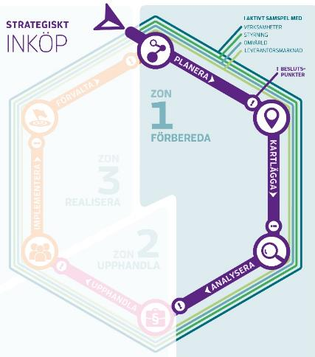
Första zonen i inköpsmodellen är ett förarbete
1
In – och omvärldsanalys
2
Behovsanalys
3
Tidig dialog och marknadsanalys
4
Förutsättningar, prioriteringar och riskanalys
5
Förkommersiell upphandling
6
Val – förfarande och affärsmodell

Slide 65


Förkommersiell upphandling
Zon 1 Förbereda
Här är ALLT zon 1
Fas 1 – utveckling av koncept/idé
Fas 2 –
prototyp och
testserie
Leverantör A
Ansökan A
Projekt A
Möjlighet att avbryta
Upphandling
Leverantör B
Ansökan B
Projekt B
Projekt B
Anbud leverantör B
Leverantör C
Ansökan C
Projekt C
Leverantör D
Ansökan D
Projekt D
Projekt D
Anbud leverantör D
Anbud leverantör X
Inbjudan att delta
Tecknande av kontrakt fas 1
Tecknande av kontrakt fas 2
Upphandling
i enlighet med upphandlings-
lagstiftningen
Notes:
Detta förfarande är ett undantag och rymmer inte inom LOU. Det gör att den förkommersiella upphandlingen inte kan överprövas. Däremot kan beslutet att genomföra en förkommersiell upphandling överklagas då det är ett myndighetsbeslut och det kan i sin tur vara felaktigt. Om det är felaktigt betyder det att den förkommersiella upphandlingen blir en otillåten direktupphandling.
I en förkommersiell upphandling sker uteslutning av lösningar i olika steg som ett sätt att hantera risk.
I det här exemplet kommer leverantör A-F in med ansökningar om att få delta i den förkommersiella upphandlingen.
Det har olika förslag på hur problemet kan lösas vilka presenteras i Anbud A-F.
Därefter tilldelas projekt A-E kontrakt för att få delta i fas 1 där de utvecklar sin idé. Leverantörerna får finansiering för faserna. Finns olika modeller för att arbeta med pris. Leverantör får föreslå pris själva, UM/UE sätter upp-till-belopp, eller fixerat pris (beauty contest).
För att välja vilka som går vidare behöver de redovisa sitt arbete och vad de har kommit fram till och hur det fungerar.
Leverantörerna kommer in med nya anbud/offerter som utvärderas. Därefter tilldelas kontrakt till fas 2 där Projekt B och D går vidare.
De jobbar då vidare med prototyper och testserier i en och samma fas. Den här fasen kan delas upp i två faser om en tror att det leder till bättre resultat. Onödigt att låta ett projekt vänta in ett långsamt.
Därefter är den förkommersiella upphandlingen klar. Precis som namnet antyder tar den bara sikte på fasen innan kommersialisering. Om myndigheten därefter vill köpa in vad som har forskats och utvecklats fram är det en vanlig upphandling som ska genomföras. Då kan även andra leverantörer, som leverantör X, delta och lämna anbud.

Slide 66

Zon 2 Upphandla
Val av upphandlingsförfarande
  Möjligheten att specificera upphandlingsobjektet och formulera kontraktsvillkor
  Innovationshöjd
  Marknadens mognad
  Interna förutsättningar
Beprövad produkt
Öppet förfarande
Ny godkänd produkt
Selektivt förfarande
Lagen om offentlig upphandling
Testprodukt
Förhandlat förfarande med/utan annonsering
Prototyp
Konkurrenspräglad dialog
Koncept
Innovationsparternskap
Upphandling av FoU
Idé

Slide 67


Innovationsupphandlingsarenan
Många aktörer arbetar tillsammans för en bred nationell kraftsamling
Ett brett engagemang hos olika aktörer med många olika kompetenser
Ett gemensamt och ett enskilt engagemang
Skapa forum för dialog och utbyte
Skapa förutsättningar för synergier mellan olika projekt och initiativ
Skapa möjligheter att testa nya idéer, metoder och verktyg
Erbjuda hjälp till självhjälp

Slide 68







Tack!
@uhmynd
^{Mer inspiration och vägledning}
^{hittar du på vår webbplats}
^{upphandlingsmyndigheten.se}
Upphandlingsmyndigheten
@upphandlingsmyndigheten
Upphandlingsmyndigheten
Frågeservice
Telefon, måndag – torsdag kl. 9–12
^{Frågeportalen, dygnet runt}
Notes:
Mer inspiration och vägledning hittar du på vår webbplats upphandlingsmyndigheten.se
Följ oss gärna i sociala medier (twitter, linkedin, facebook och youtube)

Slide 69
EU & PCP, topic Integrated Care

Slide 70


The Horizon framework programmes are political instrumentS where research and innovation are needed to achieve political priorities

Slide 71

Pre-commercial procurement (PCP)
challenges industry from the demand side to develop innovative solutions for public sector needs
provides a first customer reference that enables companies to create competitive advantage (de-risking the investment)
enables public procurers to compare alternative potential solution approaches […] to address the public need

Slide 72
SC1-BHC-20A-2020:
Pre-commercial procurement (PCP) for integrated care solutions
Scope:
What?
formal or informal, organisational solutions, personal-health and self-care solutions,
professional care solutions, ICT-based solutions
all areas of public sector interest [within care]
one specific solution/technology field or end-to-end solutions
demonstrate sustainability of the action beyond the life of the project
mobilise substantial additional national budgets for PCP and PPI
remove obstacles for introducing the innovative solutions to be procured into the market
How?

Slide 73
SC1-BHC-20A-2020:
Pre-commercial procurement (PCP) for integrated care solutions
Expected Impact:
Reduced fragmentation of demand
Increased opportunities for wide market uptake
Wide publication of results
Contribution to standardisation, regulation or certification

Slide 74
Pre-Commercial Procurement as a tool. Characteristics and advantages

Slide 75

Why public procurement is so important…
Every year, over 250 000 public authorities in the EU spend around 14% of GDP (around €2 trillion per year) on the purchase of services, works and supplies.
In many sectors such as energy, transport, waste management, social protection and the provision of health or education services, public authorities are the principal buyers.
The public sector can use procurement to boost jobs, growth and investment, and to create an economy that is more innovative, resource and energy efficient, and socially-inclusive.
High quality public services depend on modern, well-managed and efficient procurement.
Improving public procurement can yield big savings: even a 1% efficiency gain could save €20 billion per year.

Slide 76
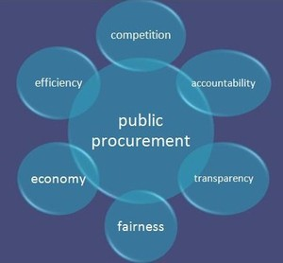
Public procurement in Health systems
- Fundamental principles
Public procurement rules are a concrete expression of the fundamental freedoms, in particular the free provision of services
However, in Europe they are affected by the EU competition law, EU internal market law and EU state aid rules

Slide 77
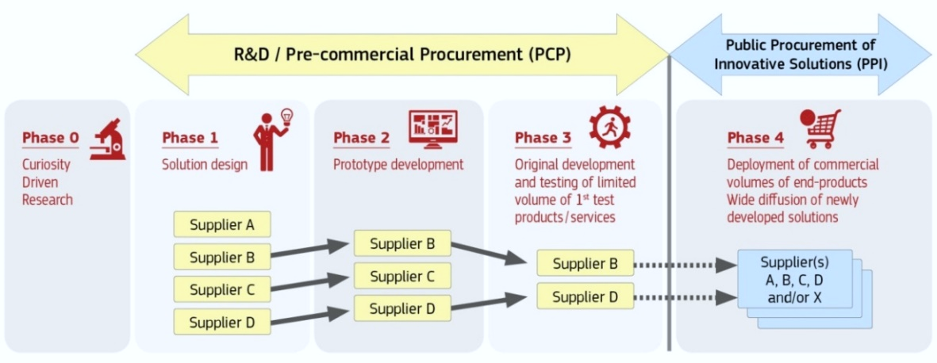
PCP vs PPI. When nothing exists…
OMC
Public Procurement of Innovation (PPI)
Pre-commercial Public Procurement (PCP)

Slide 78
Benefits for different stakeholders

Slide 79
Why PCP?
Experience of suppliers from involvement in European PCP projects show the following benefits,
  R&D funding where 100 % of the Intellectual Property Rights (IPR) remains with the supplier.
  The early engagement of end-users in the development process.
  The PCP dialogue in all stages of the development.
  Technology expert’s consultation resources available throughout the process.

Slide 80
Why PCP?
Many suppliers have expressed that the PCP was the “most useful European project” they have attended and the commonly reflected benefits for this statement of software development are:
  R&D funding where 100 % of the Intellectual Property Rights (IPR) remains with the supplier.
  The early engagement of end-users in the software development process.
  The PCP dialogue in all stages of the software development.
  Technology expert’s consultation resources available throughout the process.
It can used to compare the pros and cons of alternative competing approaches and to de-risk the most promising innovations step-by-step:
  via solution design,
  prototyping,
  development and
  first product testing.
By this Risk-benefit sharing approach where procurers share with suppliers, at market price, the benefits and risks related to the IPRs resulting from the R&D it offers a unique method to create demand- driven innovative technology based upon dialogue and co – creation.

Slide 81
CAREMATRIX PCP phases and tender process

Slide 82
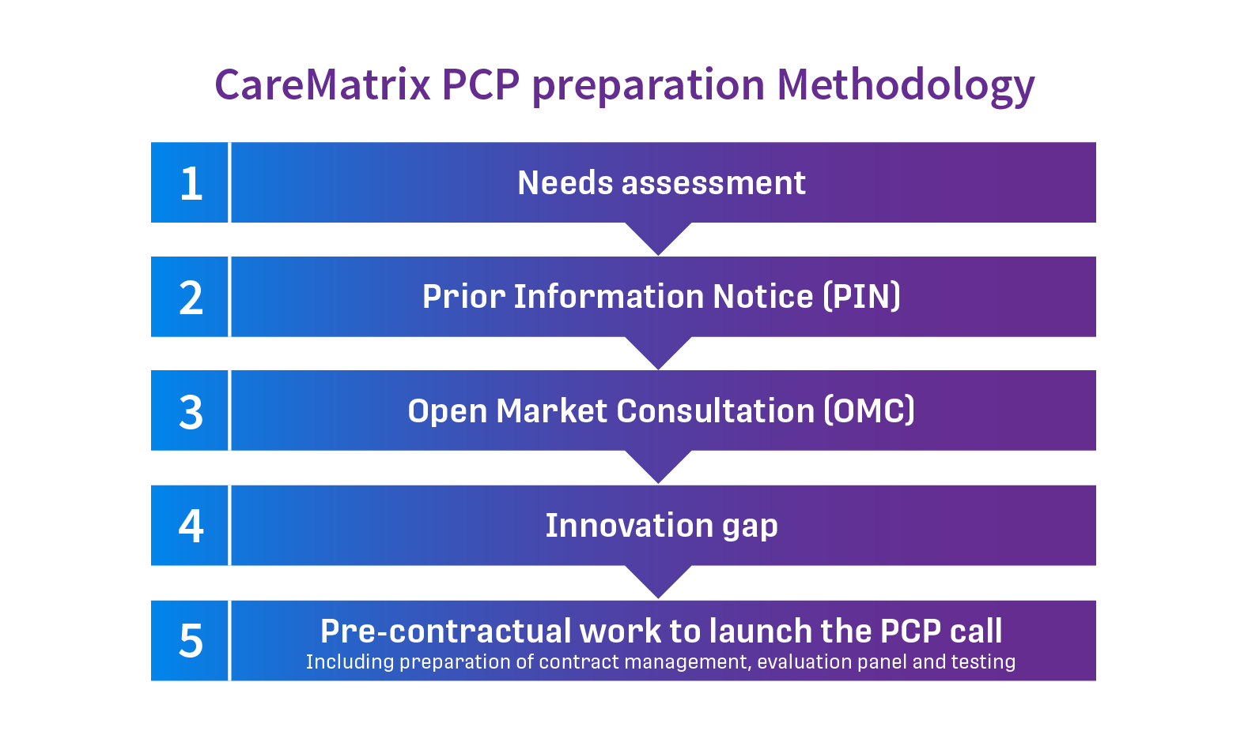

Slide 83
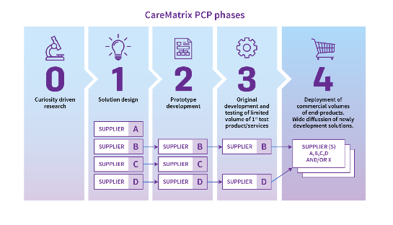
PCP implementation phase
  Launch the call
  PCP stage 1
  PCP stage 2
  PCP stage 3
  Preparation of possible upcoming PPI
Today!
’Launch the call’ marks the end of Phase 0

Slide 84
PCP PHASES
Phase 1: Solution Design Exploration
A maximum of 10 contracts awarded
Timing: 4 months (07/22 – 10/22)
Expected output of TRL level is between 1-3
Aiming at the provision at the end of the phase of a final design concept for an innovative solution
Phase 2: Prototype Development
A maximum of 5 contracts will be awarded
Timing: 7 months (12/22 – 06/23)
The expected output of TRL level is 4-5
Aiming to develop prototypes on the basis of the final concept innovative solutions selected at the end of phase 1
Phase 3: Proof of Concept – Original and limited development of first branch of products validated through field test series
A maximum of 3 contracts will be awarded
Timing: 14 months (09/23 – 10/24)
The expected output of TRL level is 6 – 7
Aiming at produce small-scale unites of the prototype to implement and run a test series in a clinical environment, on the basis of the prototypes selected at the end of phase 2
≈ €50k /contract
≈ €400k /contract
≈ €1,0m /contract

Slide 85
Q&A

Slide 86
Matchmaking & PCP boost
Anders Nilsson – Ideon Innovation

Slide 87
Unik svensk möjlighet
→ 4 stycken finansierade projekt inom samma område = Integrated care
Bättre stöd för integrerad vård/sammanhållen vård
Specialiserad hjärtsjukvård
INCAREHEART
(Region Jämtland-Härjedalen)
Carematrix (Innovation Skåne)
CRANE
(Region Västerbotten)
TIQUE
(Region Västerbotten)
Tillsammans upphandlas utveckling av framtidens hälsolösningar för upp till 200 miljoner kronor inom dessa projekt

Slide 88
Unik svensk möjlighet
→ 4 stycken finansierade projekt inom samma område = Integrated care
Nationell stödfunktion inrättad för bolag med relevanta lösningar inom digital hälsa
För att stödja bolag i,
att hitta finansiering och ansöka till (ett eller flera av) de 4 PCP-projekten
matchmaking, och bygga attraktiva konsortier
Projektstödet erbjuds november -21 → oktober -22
Koordinator Ideon Innovation, med stöd av RISE, Swedish Medtech, Karolinska
Kontakta Anders Nilsson (Ideon Innovation) för info (an@ideoninnovation.se)

Slide 89
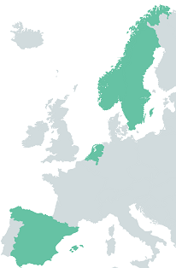

Tack !
Magnus.wallengren@innovationskane.com
Projektkoordinator Carematrix

